Slide 1


Basic Details of the Team and Problem Statement
Ministry/Organization Name/Student Innovation:
Ministry of Home Affairs
PS Code: SIH-1408
Problem Statement Title: IT SYSTEM LOG ANALYZER
Team Name: ALGOS
Team Leader Name: Syed Gayas Moinuddin Hazari
Institute Code: C-24004
Institute Name: ANDHRA UNIVERSITY COLLEGE OF ENGINEERING
Theme Name: Blockchain & Cybersecurity

Slide 2
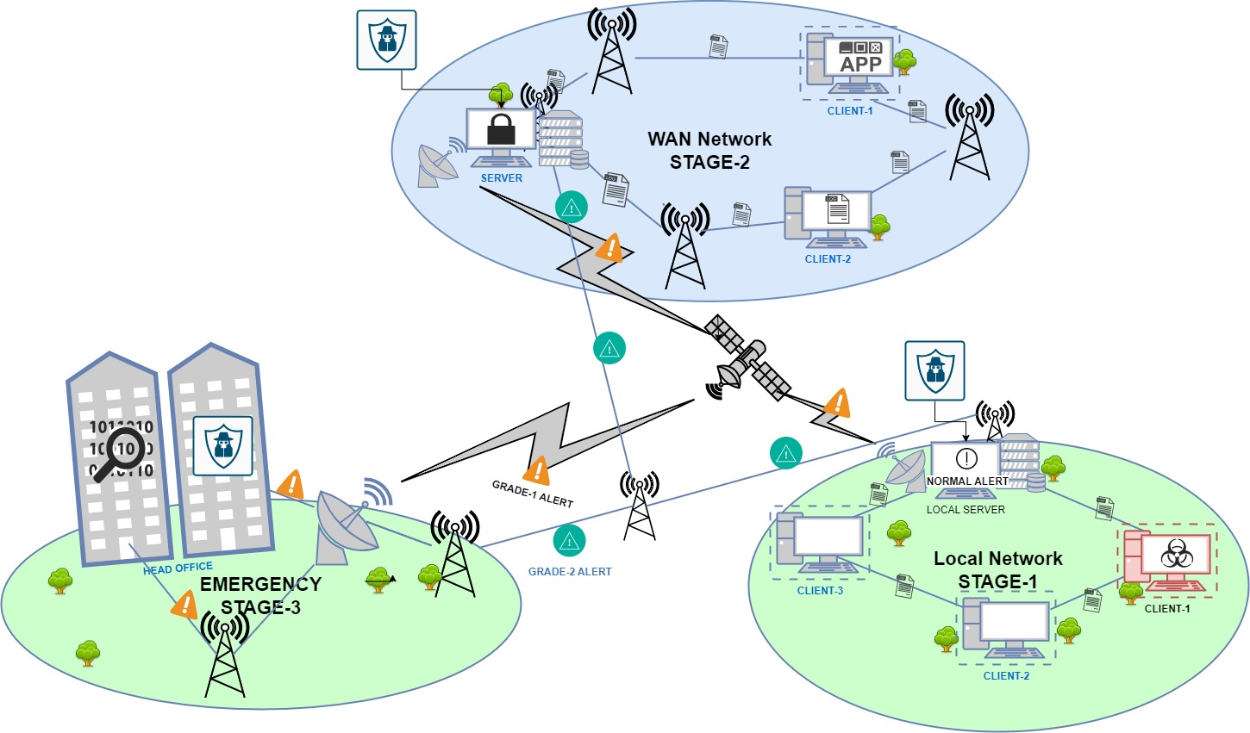














Idea/Approach Details
Primary Objective: to establish a sophisticated centralized system that can analyse log files and detect intrusive threats & breaches from the deployed CRPF units/offices across the country. The proposed product assists cybersecurity expert to approach threats & breaches through a user-friendly Dashboard.
For enhanced security of developed centralized system we include few features like Anti-Threat Counter & Alerting System(A-TCAS) with a custom ruleset to ease the information regarding threat & breaches to cybersecurity expert.
A-TCAS has a built-in AI module to improve threat detection by processing the previous threat signatures.
The centralized system development is done with the reference to MAYA OS(based on Ubuntu and a popular Linux (X-64, X-84) distribution).
An advanced alerting system uses Dashboard, Client Pop-Up, Email & SMS based on the type of threat.
The alerting system communication is done at 4 levels that includes SAN level, WAN-level, EPN-level & satellite level.
Our product also provides security at both client and server levels.
TRANSPORT ARCHITECTURE
TECHNOLOGY STACK

Slide 3
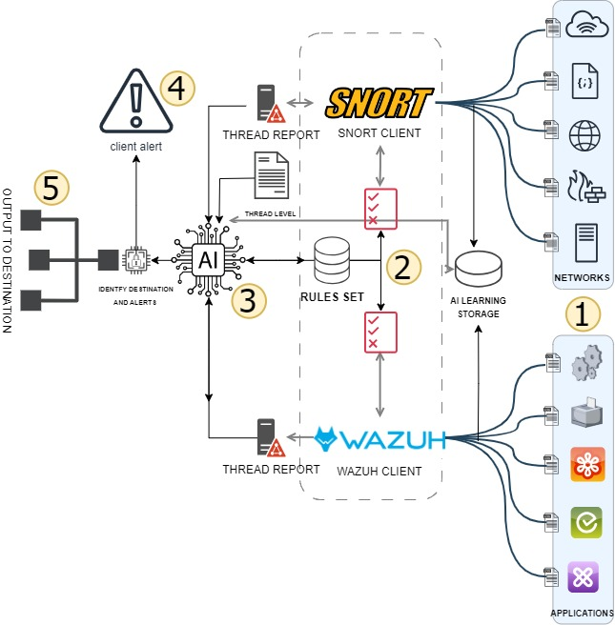
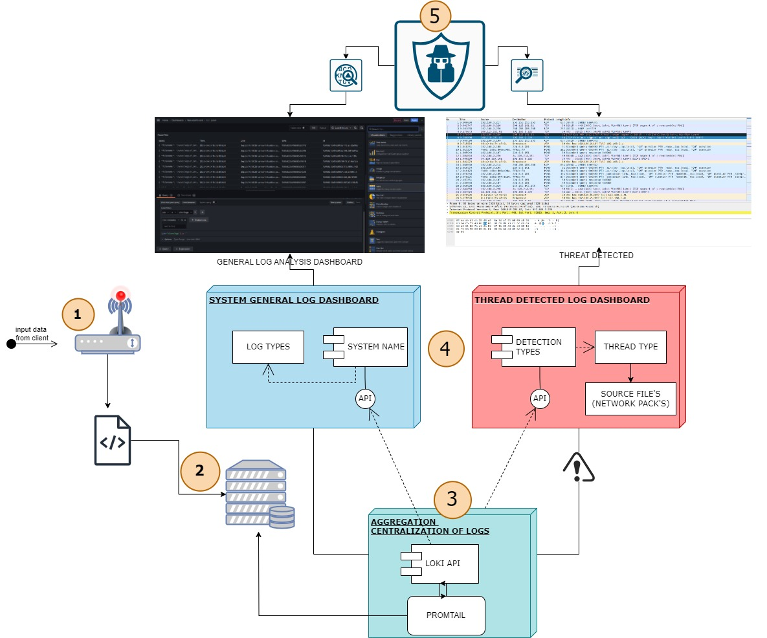
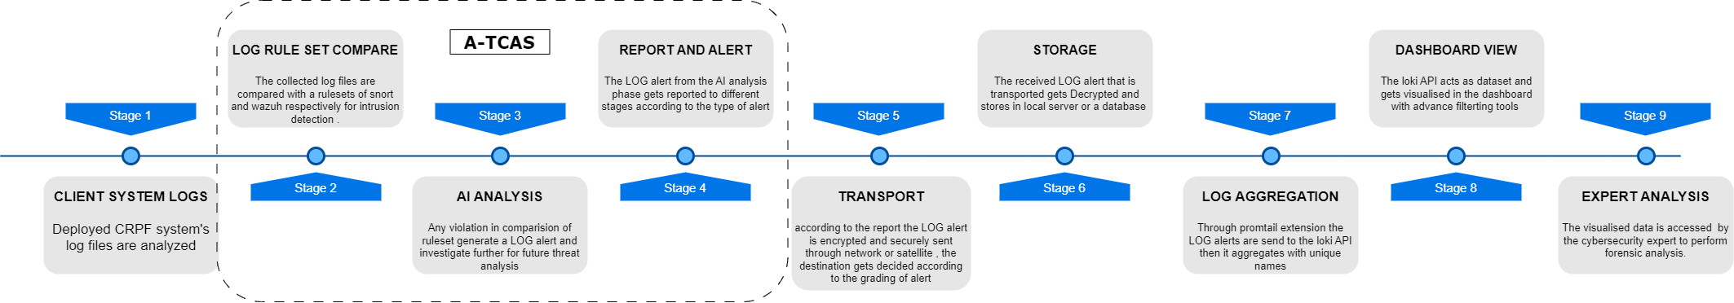
CLIENT ARCHITECTURE :
SERVER ARCHITECTURE :
WORK FLOW :

Slide 4
Idea/Approach Details
Use Cases:
Dependencies / Show topper:
Deployment in CRPF systems can enhance national defence and national security.
Generalization of product can also contribute to software domain.
Endpoint Security: Our robust endpoint security safeguards client and server devices against threats.
Incident Response & Support: In the event of a security breach, our swift incidence response and support services will minimize the system damage.
Security Gap Assessment: Our dashboard platform generates a comprehensive security report.
Client & server level security
A-TCAS(Anti-Threat Counter & Alerting System)
AI module to increase efficiency
Advance alerting system
Network & application-level log alerts
Elevated security encryption
Leading-edge transfer communication
Advanced customizable dashboard(user-friendly)
Log analytic reports
We need permissions in CRPF systems can enhance the security of our national defense
Please use below link to monitor the project’s progress:
https://drive.google.com/drive/folders/10lI9bVzgfxxWuxpiXFIRzOtZSE9qCdov?usp=drive_link

Slide 5

Business Model
Value propositions
Customer relationships
A sophisticated centralized system that can analyze log files and detect intrusive threats & breaches
If generalised then subscription-based relationship with customers
Customer segments
Key activities
CRPF units of various sizes
CRPF offices with different security requirements
Developing and maintaining the centralized system that detects intrusive threats & breaches
Providing customer support and training with a user-friendly dashboard
Channels
Key partners
Partner channels Direct sales
Cybersecurity companies
System integrators
Hardware and software vendors
Cost structure
Revenue streams
The main costs associated with developing and maintaining the product as well as providing support to customers and infrastructure costs.
Subscription based monthly or annual fee to access the software.
Target market
CRPF units/offices, government agencies, security organisations, software solutions across the country

Slide 6
Team Member Details
Team Leader Name: Syed Gayas Moinuddin Hazari Branch : B.tech Stream :CSE Year : III
Team Member 1 Name: Tamarana Sai Raj Guna Branch : B.tech Stream : CSE Year : III
Team Member 2 Name: Vulli SasiKanth Branch : B.tech Stream : CSE Year : III
Team Member 3 Name: Vallesi Abhishek Branch : B.tech Stream : CSE Year : III
Team Member 4 Name: V Gagana Geethika Maya Branch : B.tech Stream : CSE Year : III
Team Member 5 Name: D S N V P Raghavendra Varma Branch : B.tech Stream : CSE Year : II
Team Mentor 1 Name: PROF. I.S.Srinivasa Rao
Category: Academic
Expertise: IOT, BLOCK CHAIN, MINING, REAL TIME OS, SECURITY, SENSOR NETWORKS, AI, EMBEDDED SYSTEMS. EDGE COMPUTING Domain Experience (in years): 20+
Team Mentor 2 Name: PROF. Ramjee Maddula
Category: Academic
Expertise: IOT, BLOCK CHAIN, MINING, REAL TIME OS, SECURITY, SENSOR NETWORKS, AI, EMBEDDED SYSTEMS. EDGE COMPUTING Domain Experience (in years): 20+

